Slide 1
MICROECONOMICS
(BCS 2002 & BSE 2002)/BA]
SPRING-2024
Dr. S. Ghiasul Haq ghiasul786@gmail.com

Slide 2
(C) DEMAND AND SUPPLY

Slide 3
Unlimited Wants Limited Resources
SCARCITY
What to Produce
For Whom to Produce
How to Produce
PRICE
DEMAND
supply

Slide 4
LECTURE-7 DEMAND
Lecture 7(i)
Demand and Law of Demand
Demand & Inverse Demand Function
Lecture 7(ii)
Demand-Change and Shift in Demand
Determinants of Demand & Full Demand Function
Lecture 7(iii)
Price Elasticity Demand
Income and Cross Elasticity of Demand

Slide 5
Demand…..
What is Demand?
Demand is willingness and ability to pay for a product
What is Law of Demand?
Other things remaining the same, there is an inverse relationship between the price of a good and quantity of demand/the quantity buyers are willing to purchase in a defined time period.

Slide 6
Law of Demand
Part 1. As PRICE increases, DEMAND decreases
Part 2. As PRICE decreases, DEMAND increases
Price goes up
Demand goes down
THEN
Price goes down
Demand goes up
THEN

Slide 7
Demand…..
DEMAND SCHEDULE FOR COMMODITY X
QUANTITY DEMANDED | PRICE PER DOZEN (Rs.)
120 | 20
100 | 35
80 | 50
60 | 65
40 | 80
20 | 95
0 | 110

Slide 8
Demand Function &Equation..
Demand is the function of Price where Price is Independent Variable and Demand is Dependent Variable.
Demand Curve –Algebraic Equation:
Qd = a- - bP [General Form]
Qd = 50 – 2P
Continued Next Slide……

Slide 9
Demand ….
DEMAND EQUATION
Qd= 50-2P
Derived Demand Schedule
 | Demand | Price
1 | 46 | 2
2 | 42 | 4
3 | 38 | 6
4 | 30 | 10
5 | 10 | 20
6 | 0 | 25

Slide 10
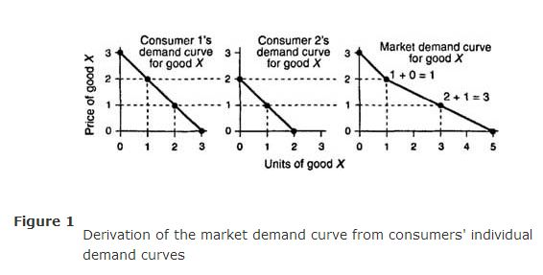
….MARKET DEMAND
The market demand curve for good X includes the quantities of good X demanded by all participants in the market for good X. The market demand curve is the horizontal summation of all individual demand curves.
Simple example with two consumers only
.

Slide 11
Inverse Demand Function
In economics, an inverse demand function is the mathematical relationship that expresses price as a function of quantity demanded (it is therefore also known as a price function).
Qd = 50 – 2P [Demand Function]
The Inverse Demand Function will be:
2P = 50-Qd and P= 25-0.5Qd
Help to find the price to achieve a Target Sale (create Demand) e.g. Create Demand of 30 the P woud be
P= 25-0.5X30 =25-15= Rs.10 per Dozen

Slide 12
TO BE CONTINUED as LEC-7(ii)

